Slide 1
HDSC August ’22 Premiere Project Presentation: Stock trade
Presented by
Team Pandas
on
27 - 08 - 2022

Slide 2
The Team
Abdulhfiz Abdus-salaam | Adesokan Sulaimon Adewale
Agbata Dikson Ukolojo | Ashinze Emmanuel Chidi
Bukola Zainab Agoro | Chibuike Lawrence Orji-oko
Esther Chizitere Amadi | Favour Emmanuel
Favour Uwaishe | Joseph Komolafe
Modupeoluwa Adedeji | Muhammed Balogun
Oghenekaro Oghoroko | Okwudiri Godswill Nwagu
Oluwasayo Akinkunmi | Quadiri Omotesho
Ramsey Ithacius Njema | Subomi Oyewole
Victoria Ihenetu | Poucheu Mbonda Florian-wilfred
Project Lead
Tunde Egunjobi
Assistant Project Lead
Hammed Ishola Abdullah
Query Analyst
Flora Okezue

Slide 3
Introduction
Stock trading is an online buying and selling of companies' shares for profits. Understanding trading determines success in the business.

Slide 4
Problem Statement
The aim of the project is to perform an EDA(Exploratory Data Analysis) on the stock prices of three companies and build a model that will predict the next day's stock price

Slide 5
Our approach
Data Source
Exploratory data analysis (EDA)
Feature engineering
Model building
Model Deployment

Slide 6
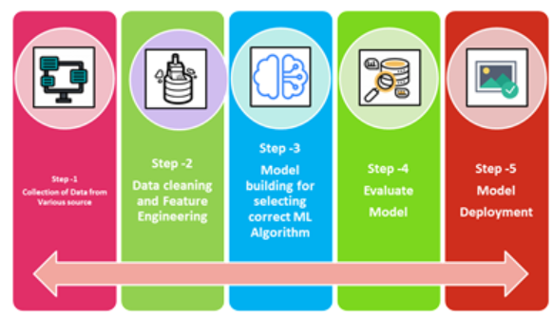

Slide 7
Dataset Description
This dataset is obtained from Kaggle. It focuses on the historical stock prices of tech companies.
This dataset consists of 851264 rows and 7 columns, it contains the opening and closing of stock prices, the low and high price of stock price, and its volume.

Slide 8
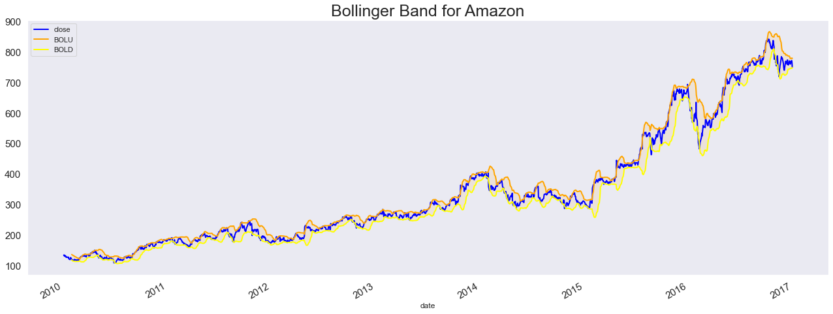
Amazon has a very tight Bollinger which shows that the market was less volatile.

Slide 9
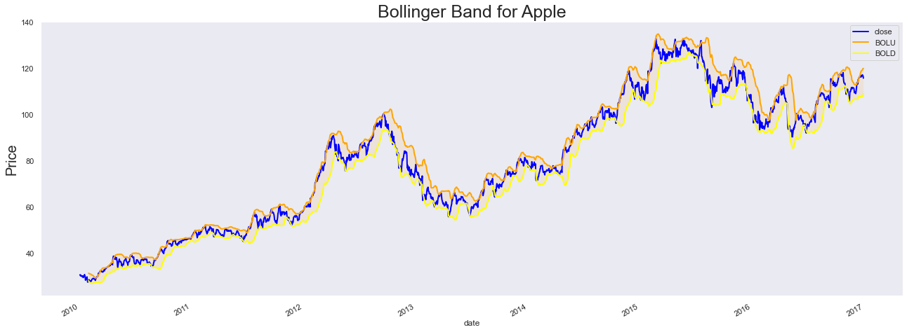
The Bollinger Band is not too tight and this indicates high volatility

Slide 10
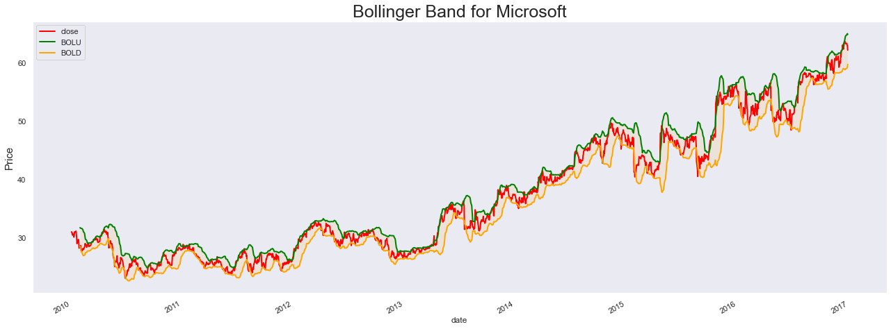
Microsoft has a narrow Bollinger which shows the volatility of the asset

Slide 11
Feature Engineering
In this stage, we filled out a closed column and reshaped the data into three dimensions. After which, the data were scaled using the MinMax Scaler.
This method was chosen to help deal with outliers and also to optimize machine learning performance.

Slide 12
Model building and deployment
Time series is a special type of data set in which one or more variables are measured over time. In time series, however, observations are measured over time. Each data point in the data set corresponds to a point in time. This means that there is a relation between different data points of the dataset. This has important implications for the types of machine learning algorithms that can apply to the time series dataset. LSTM is the preferred model. LSTM MODEL was developed and deployed for live predictions.

Slide 13
Why? You may ask
LSTMs are Recurrent Neural Networks. Neural Networks are very complex machine learning models that pass input data through a network. Each node in the network learns a very simple operation. The neural network consists of many such nodes. The fact that the model can use a large number of simple nodes makes the overall prediction very complex. Neural Networks can therefore fit very complex and nonlinear data sets.
Other models applicable include ARIMA, Prophet, and DeepAR.
Link: https://theabdullahishola.github.io/HDS/

Slide 14
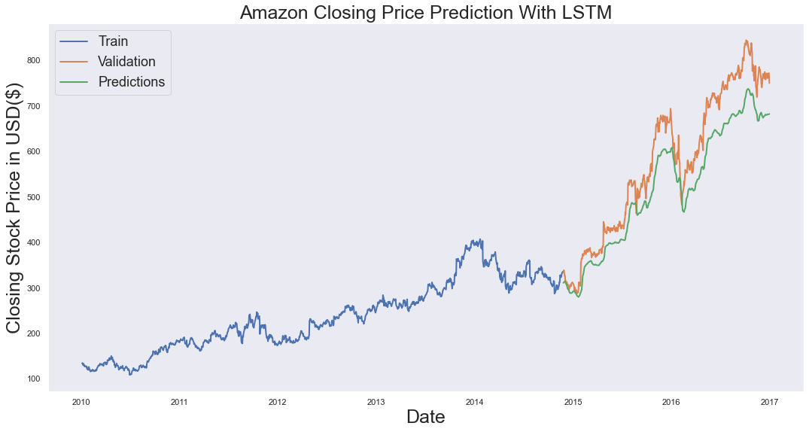
RESULTS

Slide 15
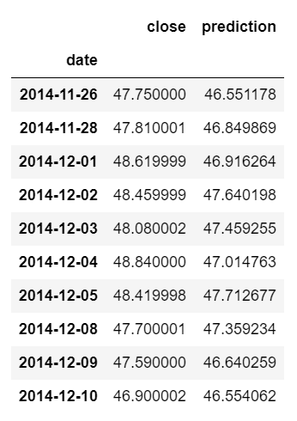
Using AMAZON as an example, the difference between the Predicted and actual values is not large which reflects the accuracy of the model. The model has an RMSE of 29.78.

Slide 16
Summary
Insights about the stock market are needed to grow a financially stable business, hence the need for analysis and use of machine learning algorithms to help with business decisions through forecasting.
After an in-depth Analysis of the stocks, A deep learning algorithm, LSTM, was used to make predictions to help forecast the prices of stocks. However, deep learning models work better with larger datasets, hence for better analysis, a larger dataset will be preferred.

